Slide 1
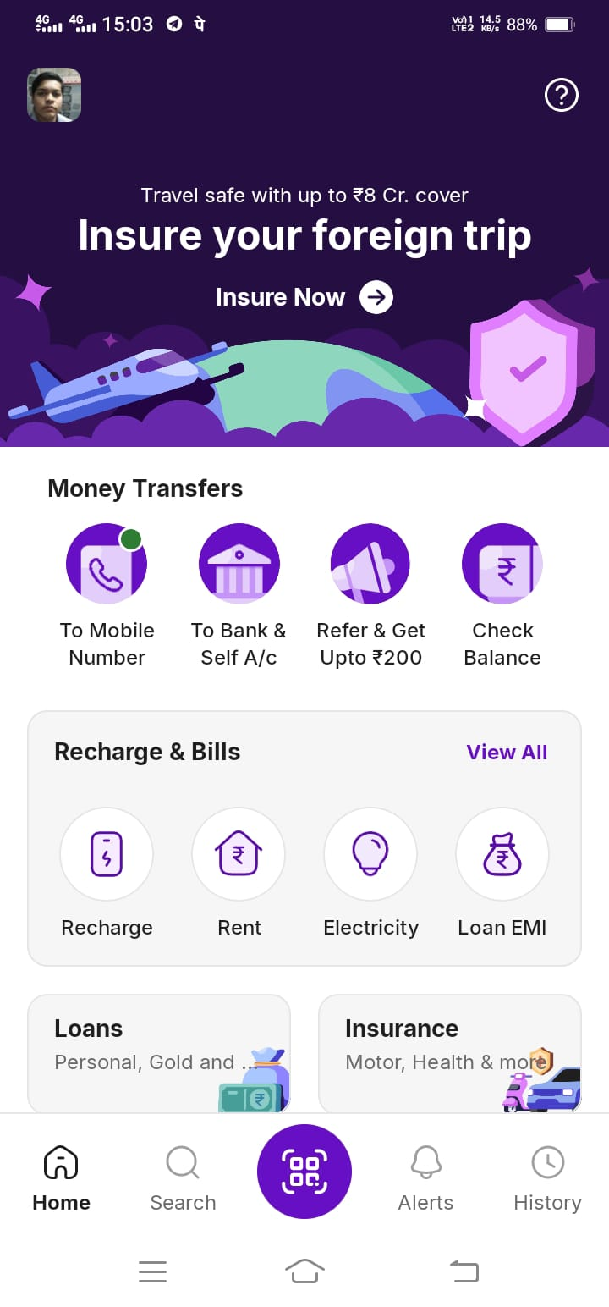




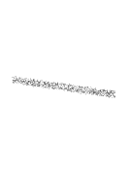







COLORS:-
Primary colors
Purple – Used across app for branding
Secondary colors
White Black Gray
Accent colors:
Green -> for success
Red -> for errors
Blue -> for links/offers

Slide 2
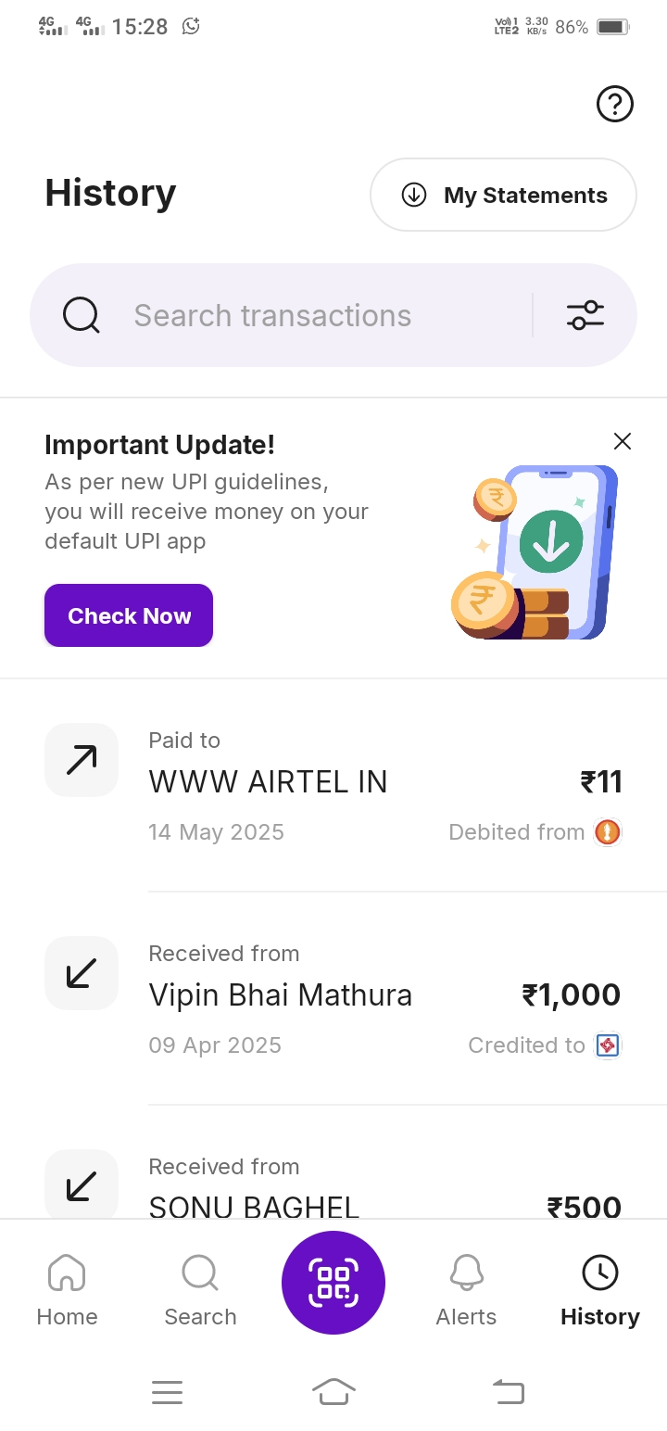


TYPOGRAPHY:-
Title Text – Big and Bold
Example :- “Recharge and Pay Bills” it's bold and larger so you notice it first
Body Text – Medium size
Example :- recent transaction: “11 sent to www airtel in”
Subtext/Labels — Small and Light
Example :- “via bank a/c” — smaller and lighter for secondary info

Slide 3
Buttons:-
Primary Button Solid purple background, white text, rounded corners Example :- The “Pay Now” or “Recharge” button is big, purple, rounded, and grabs your attention.
Secondary Button Outlined or light gray with dark text Example :- On some settings or side options, you'll see buttons that are more subtle — these are less urgent actions.
Icon Buttons Circular or square, often in quick action menus (e.g., QR scan, bill pay)

Slide 4



ICONS:-
(Visual Shortcuts)
Simple, recognizable icons + labels
Example:- 💡 Electricity
📱 Mobile Recharge
💸 Send Money

Slide 5





LAYOUTS:-
Top Section
Example:- Shows adds, with a quick click, Profile icon on left side, Help button on top right
Middle Section
Example:- A grid of services: Recharge, Rent, Electricity, Loan EMI
Insurance — all in square icons neatly aligned.
Bottom Navigation Bar
Example:- Tabs: Home, Search, Scanner, Alerts, History

Slide 6
CONCLUSION:-
These elements together enhance usability, build trust, and make navigation intuitive for all users.
Phone Pe UI create a clean, user-friendly, and visually appealing experience
It also support payments from other platforms.

Slide 7






UX OF PHONE PE:-
Navigation
Home screen is well-structured with icons and labels for Recharge, Pay Bills, and Send Money.
Bottom navigation bar (Home, History, My Money, Switch, Stores) helps users easily move between major sections.
Search bar and QR scanner are always visible for fast access.
Pain Points
No dark mode
Help and support options are buried in menus
User Journey & Task Completion
Quick recharges, UPI transfers, and bill payments are optimized with recent history and auto-fill.
Feedback (like "Payment Successful") builds trust and clarity during important actions
Language support improves access for users across India, making onboarding easier.

Slide 8
COMPARE UI VS UX
UI (USER INTERFACE) | UX (USER EXPERIENCE)
Visual layout and design of the app | Overall experience of using the app
Look, feel, colors, fonts, buttons, icons | Ease, flow, satisfaction, and task success
Make the app visually appealing | Make the app easy, smooth, and enjoyable to use
Consistent fonts and color contrast | Gets positive feedback after successful transactions
Figma, Adobe XD, Sketch (for screens & visuals) | User research, journey maps, wireframes, testing
A neat and attractive interface | A fast, functional, user-friendly experience

Slide 9



Explore UI/UX Design Tools
Figma
It is a cloud based designing tool
It is used in UI design, prototyping, collaboration
Sketch
It is a macOS based UI design tool
It is used in UI design, vector editing, and prototyping
Adobe XD
It is a Vector-based UI/UX design tool by Adobe
It is used in Wireframing, high-fidelity design, prototyping

